Slide 1

CS401 Modern Programming Practices (MPP) Dr. Shafqat Ali Shad
MAHARISHI UNIVERSITY of MANAGEMENT
Engaging the Managing Intelligence of Nature
Computer Science Department

Slide 2
© 2015 Maharishi University of Management, Fairfield, Iowa
All rights reserved. No part of this slide presentation may be reproduced or utilized in any form or by any means, electronic or mechanical, including photocopying or recording, or by any information storage and retrieval system, without permission in writing from Maharishi University of Management.

Slide 3
Lecture 3: Inheritance and Composition
Reflecting the Whole in the Part

Slide 4
Wholeness of the Lesson
Inheritance and Composition are types of relationships between classes that support reuse of code. Inheritance makes polymorphism possible, but can lock classes into a structure that may not be flexible enough in the face of change. Composition is more flexible but does not support polymorphism. Composition and inheritance are techniques based on the principle of preserving sameness in diversity, silence in dynamism

Slide 5
Outline of Topics
Review of inheritance concepts and implementation in Java
Wrong uses of inheritance
Benefits of inheritance
Problems with inheritance
Fragility
Rectangle-Square Problem
Violates encapsulation: Ripple effect
Enhancing HashSet
Best Practice (J. Bloch): Design for inheritance or else prevent it
Using Composition
Instead of inheritance – Example: a Stack class
In combination with inheritance – Example: Inheriting from a Role

Slide 6
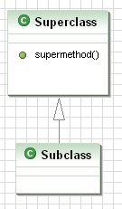
Review of Inheritance
class Superclass {
protected void supermethod() {
int x = 0;
}
}
class Subclass extends Superclass {
}
class Main {
public static void main(String[] args) {
Superclass sub = new Subclass();
//subclass has access to data and
// non-private methods of superclass
sub.supermethod();
}
}

Slide 7
Example
(more general, abstract)
superclass
Relationship between a general and a specific class
IS-A relationship
no multiplicity
public class Shape {
...
}
(more specific, concrete)
subclass
public class Rectangle extends Shape {
...
}
Rectangle inherits all attributes
and methods from Shape that are not private

Slide 8
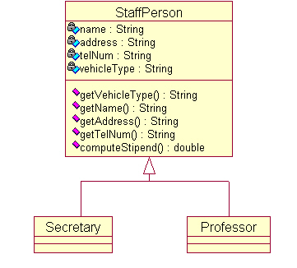
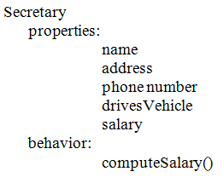
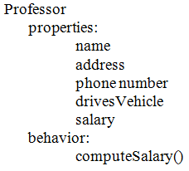
Inheritance Arises . . .
As a way to generalize data and behavior of related classes
See demos in lesson3.lecture.polymorphism1, lesson3.lecture.polymorphism2

Slide 9
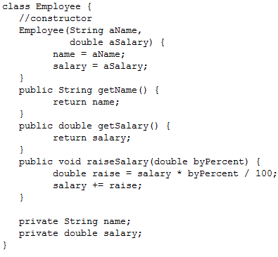
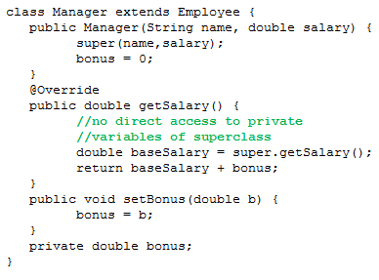
And . . .
As a way to extend the behavior of a particular class

Slide 10
Rules Concerning Inheritance
A subclass constructor must make use of one of the superclass constructors (see Manager class), but does not need the same signature as any of these constructors
A class can have multiple (overloaded) constructors. To call one constructor from another, “this” is used (must be the first line of the constructor). Example: public Employee(String name) { this(name, 0.00);
}
A constructor can call a superclass constructor using “super”. See Manager class (also notice super is used in another way to call a superclass method).
To prevent a class from having any subclasses, the class can be declared final.
If A is a subclass of class B, when the constructor of A is invoked, there is a specific sequence of steps by which the static/instance variables are initialized and the bodies of the two constructors are executed.
DEMO: package lesson3.lecture.orderofexec

Slide 11
Using the Default Constructor
A subclass may make use of the implicit (default) constructor only if either
the no-argument constructor of the superclass has been explicitly defined, OR
no constructor in the superclass is explicitly defined
In either of these cases, the subclass may make use (possibly implicitly) of the superclass' default constructor.
Example //This is ok
class Employee{
Employee(String name, double salary) {
//…//
}
//explicit coding of default constructor
//since another constructor is present
Employee() {
//…//
}
}
class Manager extends Employee {
//no explicit constructor call here, //so the superclass default
//constructor is used implicitly
}
Example
//This is ok
class Employee{
//…//
}
class Manager extends Employee {
//…//
}

Slide 12
Overriding a method
A subclass can change inherited behavior of the super class by overriding methods
To override an inherited method, the method in the subclass must have the same signature and return type as the method in the superclass.
Best practice is to also add the @Override annotation
@Override
public String toString() {
return "Employee [salary=" + salary + ", getFirstname()="
+ getFirstname() + ", getLastname()=" + getLastname()
+ "]";
}

Slide 13
Best Practices for Using Inheritance
IS-A Principle Class C may extend class D if C IS-A D. Example: Manager IS-A Employee Example: Secretary IS-A StaffPerson
Liskov Substitution Principle (LSP): C may extend D if an object of type C may be used during execution where an object of type D is expected, without breaking the code.
Example We may use a Manager instance wherever an Employee instance is expected, so having Manager as a subclass of Employee adheres to LSP.

Slide 14
Outline of Topics
Review of inheritance concepts and implementation in Java
Wrong uses of inheritance
Benefits of inheritance
Problems with inheritance
Fragility
Rectangle-Square Problem
Violates encapsulation: Ripple effect
Enhancing HashSet
Best Practice (J. Bloch): Design for inheritance or else prevent it
Using Composition
Instead of inheritance – Example: a Stack class
In combination with inheritance – Example: Inheriting from a Role

Slide 15
Wrong Use of Inheritance: Convenient Code Re-use
We’ve written the code for move() in our car class, and we want to re-use this code for our bicycle class.
Why is this a bad design decision?
Changes to the Car class would be inherited by Bicycle and such changes may not make sense. For instance: Car class may be updated to have a choice between automatic and manual transmission, and then be equipped with an abstract method updateTransmission(). Then Bicycle will have to implement it – but it would be meaningless to do so.
Notes:
Even if this code would work initially (which could be questioned), in the long run, because a bicycle is not a car, changes to the car class that are fine for a car would automatically be inherited by the bicycle as well!
Example: car class may be updated to have a choice between automatic and manual transmission.
This change would not make any sense for the Bicycle, but when would you find out? If the new method updateTransmission() is abstract, then Bicycle will break until it either implements it (makes no sense) or declares it abstract.

Slide 16
Inheritance Just for Code Reuse
The following classes all have a name property
Why is this use of inheritance a poor design decision?
Rigidly binds these classes together
Name may evolve in different ways
Scenario: What if Person is updated to have firstName and lastName?
Notes:
Again, even though this might work as a short term solution, in the long run, we may want to change Person to have a firstname and lastname, how would you deal with that? The problem is that although we’ve re-used this property, this property really doesn’t actually have to mean the same thing to these different concepts. Causing problems in the long run when the code gets updated for one, and no longer reflects how it is supposed to be for the others.

Slide 17
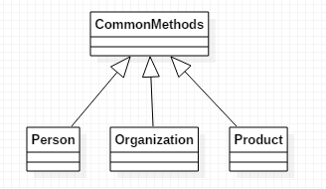
What about using inheritance like this?
Problems:
- Violates IS-A and LSP
Wastes inheritance opportunity
CommonMethods will evolve into a mess – eventually it will contain methods that may be useful only for one or two of its subclasses.
Use utility class instead

Slide 18


Exercise 3.1
For which of the pairs A, B of classes shown below is it correct to say that A inherits from B?
Cat, Animal
DigitalWatch, Timepiece
HumanBeing, Being
CompanyPresident, Employee
Customer, Account
Book, Library
Stack, List
Circle, Ellipse
Circle, Cylinder

Slide 19
Exercise 3.1 - Solution
For which of the pairs A, B of classes shown below is it correct to say that A inherits from B?
Cat, Animal - Good (Cat IS-A Animal)
DigitalWatch, Timepiece – Good (DigitalWatch IS-A Timepiece)
HumanBeing, Being – Not Bad (but maybe not useful)
CompanyPresident, Employee - Good (usually the case)
Customer, Account – Bad (Customer is not an Account)
Book, Library – Bad (Book is not a Library though it may belong to one)
Stack, List - ?? See upcoming slides
Circle, Ellipse ?? See upcoming slides
Circle, Cylinder ?? See upcoming slides

Slide 20
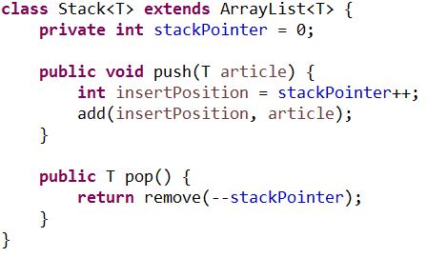
Subtle Mistake Using Inheritance
What’s wrong with the following implementation of a stack? (Hint: Problem shows up when you try to apply LSP.) Note: the Java 1.1 library implementation of Stack made the same mistake – jdk 1.2 fixed it, but IS-A principle still violated.
See Demo: lesson3.lecture. stacklinkedlist
Notes:
As LSP says C may extend D if an object of type C may be used during execution where an object of type D is expected, without breaking the code. Example: We may use a Manager instance wherever an Employee instance is expected, so having Manager as a subclass of Employee adheres to LSP.
Stack is not a Vector so it should not be extended by Vector, Similarly property list is not hash table so it should not extend from Hashtable. It must be handled through composition rather inheritance.
Here's a simple example that shows the problem of Stack allowing un-Stack-like behavior:
Stack<String> stack = new Stack<String>();
stack.push("1"); stack.push("2"); stack.push("3");
stack.insertElementAt("squeeze me in!", 1);
while (!stack.isEmpty())
{ System.out.println(stack.pop()); } // prints "3", "2", "squeeze me in!", "1"

Slide 21
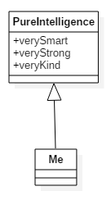
Main Point 1
Inheritance is used to model IS-A relationships and must obey the Liskov Substitution Principle.
Although Inheritance offers reuse (the subclass inherits all public and protected methods and attributes), reuse should never be the sole reason for creating an inheritance relationship.
The field of pure intelligence is inherited by everyone, and can easily be accessed through the practice of the TM technique.

Slide 22
Outline of Topics
Review of inheritance concepts and implementation in Java
Wrong uses of inheritance
Benefits of inheritance
Problems with inheritance (even when used correctly)
Fragility
Rectangle-Square Problem
Violates encapsulation: Ripple effect
Enhancing HashSet
Best Practice (J. Bloch): Design for inheritance or else prevent it
Using Composition
Instead of inheritance – Example: a Stack class
In combination with inheritance – Example: Inheriting from a Role

Slide 23
Benefits of Inheritance
It reduces code redundancy
Subclasses are much more succinct (smaller class file) than they would be without inheritance. (E.g. Faculty, Secretary classes.)
You reuse and extend code that has already been thoroughly tested – without modifying it. (E.g. Manager class)
You can derive a new class from an existing class even if we don’t own the source code for the latter! (See demo: lesson3.lecture.inheritance1.MyStringList.)

Slide 24
Outline of Topics
Review of inheritance concepts and implementation in Java
Wrong uses of inheritance
Benefits of inheritance
Problems with inheritance (even when used correctly)
Fragility
Rectangle-Square Problem
Violates encapsulation: Ripple effect
Enhancing HashSet
Best Practice (J. Bloch): Design for inheritance or else prevent it
Using Composition
Instead of inheritance – Example: a Stack class
In combination with inheritance – Example: Inheriting from a Role

Slide 25
Fragility of Inheritance
Subclasses of a superclass – even when the IS-A criterion is met – may use the superclass in unexpected ways leading to broken code.
Example: the Rectangle-Square Problem
See lesson3.lecture.inheritance2
The Rectangle-Square Problem arises because of the presence of setters.
Code shows that Square should not inherit from Rectangle because of LSP
If setters are not allowed (which would mean that Square and Rectangle are considered immutable), there is no problem about inheritance.
Viewing a Circle as a subclass of Ellipse leads to the same set of issues.

Slide 26

Inheritance Violates Encapsulation: The Ripple Effect
If A is a subclass of B, even if A is not modified in any way, a change in B can break A. (This is called the Ripple Effect.)
Example 1: Suppose A overrides all methods in B by first validating input arguments in each method (for security reasons). If a new method is added to B and A is not updated, the new method introduces a security hole. (lesson3.lecture.inheritance4)

Slide 27
Example 2: Extending HashSet – see lesson3.lecture.inheritance3.
Problem: In implementation of HashSet, addAll calls the add method, so we are incrementing addCount too many times in calls to addAll.
Fix: Don’t increment addCount in addAll operations
The real problem: Now ExtendedHashSet depends on an undocumented implementation detail of HashSet. If creators of HashSet change the implementation of addAll, ExtendedHashSet could break.
This is an example of the Ripple Effect; the internal implementation of addCount in ExtendedHashSet can be undermined by a change in implementation in the super class – this is a violation of encapsulation.
Notes:
The problem is that the addAll method of the class HashSet is implemented by calling the add method for all elements of the collection c. Since add is overriden by the subclass every inserted element is counted twice. We could solve this problem by removing the increment of addCount in the overriding addAll method. However, the new solution would remain susceptible to the introduction of bugs whenever the implementation of HashSet changes. That is, the solution with subclass inheritance breaks encapsulation.

Slide 28
Outline of Topics
Review of inheritance concepts and implementation in Java
Wrong uses of inheritance
Benefits of inheritance
Problems with inheritance (even when used correctly)
Fragility
Rectangle-Square Problem
Violates encapsulation: Ripple effect
Enhancing HashSet
Best Practice (J. Bloch): Design for inheritance or else prevent it
Using Composition
Instead of inheritance – Example: a Stack class
In combination with inheritance – Example: Inheriting from a Role

Slide 29
Designing for Inheritance
To support inheritance, a class must document which overridable methods it uses in its own internal operations. Example: the remove method in AbstractCollection
More subtle points may also need to be considered: See Bloch, Effective Java, pp. 88 - 89
Notes:
The java.util.HashSet class's remove() method uses reference equality (==) to test for object membership, rather than using the object's equals() method, as specified in the AbstractCollection specification. AbstractCollection states that remove() "removes an element e such that (o==null ? e==null : o.equals(e))" The subclass HashSet overrides the remove() method, but there is no statement that this contract is different from its super-class. Presumably, this behaviour is because the HashSet is backed by a Hashtable, and, possibly for performance reasons, reference equality is used rather than the (potentially) more expensive equals() method. At the very least, this sort of behaviour should be documented in the subclass (HashSet) to state that equality is via reference and not equals as stated in the super-class contract.

Slide 30
Forbidding Inheritance
Two ways:
Make the class final, OR
Make all constructors private and provide static factory methods to create instances.

Slide 31
Outline of Topics
Review of inheritance concepts and implementation in Java
Wrong uses of inheritance
Benefits of inheritance
Problems with inheritance (even when used correctly)
Fragility
Rectangle-Square Problem
Violates encapsulation: Ripple effect
Enhancing HashSet
Best Practice (J. Bloch): Design for inheritance or else prevent it
Using Composition
Instead of inheritance – Example: a Stack class
In combination with inheritance – Example: Inheriting from a Role

Slide 32
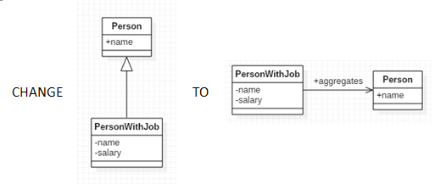
Using “Composition” Instead of Inheritance
To avoid the pitfalls of inheritance, it is always possible to use composition instead of inheritance.
To illustrate the technique, imagine two classes, Person and PersonWithJob. Instead of asking PersonWithJob to inherit from Person, you can compose Person in PersonWithJob and forward requests for Person functionality to the composed class. We still get the benefit of reusing Person.
lesson3.lecture.composition1

Slide 33
Example: Better Implementation of Stack
See lesson3.lecture.composition2 for an implementation using Composition.

Slide 34
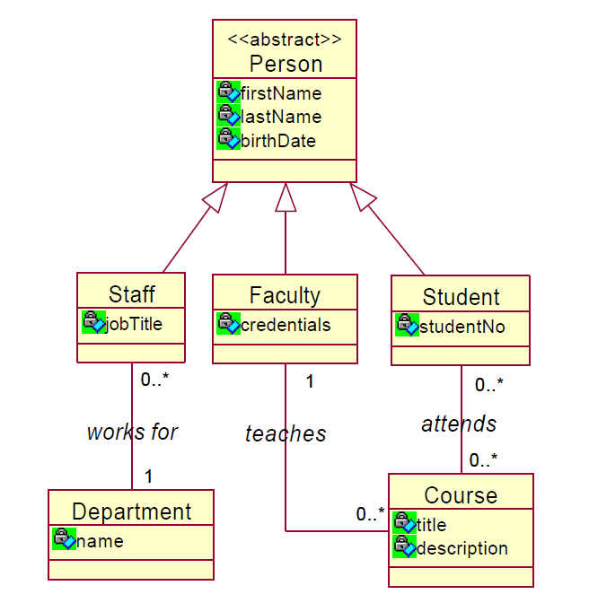
Example Composition over Inheritance
What are some limitations of this design?

Slide 35

Example Composition over Inheritance
Problems:
Inheritance is a static relationship and it must be decided at object construction time which type of person someone is
Once constructed, a person cannot change from being a Student to being Staff or Faculty
In the real world people change all the time
Also a person cannot assume multiple roles of being a Staff member and a Student at the same time
Again, not how it really works

Slide 36


Exercise 3.2 Composition over Inheritance
Think of a way to redesign this class hierarchy using composition. You do not need to eliminate inheritance, but can you use composition to solve the problems mentioned in the previous slide?

Slide 37
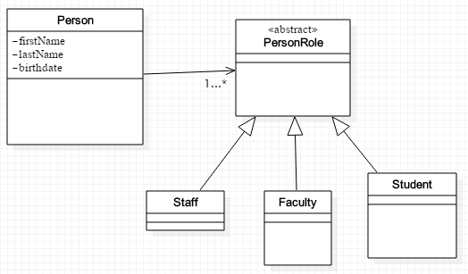
Solution
Introduce a PersonRole class. This allows a Person to assume one or more PersonRoles

Slide 38
Main Point 2
Inheritance should be used only when you have a clear IS-A relationship and even then, a careful plan for using inheritance should be thought through. Otherwise, it is better to forbid inheritance and use composition.
Even in clear IS-A relationships, inheritance may not be the best choice because of its inflexibility.
Software relationships that reflect the real world are more natural and easier to understand. Likewise, life in accord with natural law tends to go forward without obstacles; life in violation of natural law tends to be “bumpy”.

Slide 39
Summary
Today we considered some of the advantages and disadvantages of using inheritance. We must be cautious when using inheritance because it is a permanent relation for the lifetime of an object. This fact can conflict with our goal to build software that supports change and extensibility.
In general, composition has better support for change so we favor using composition except in cases where we have a clear ‘is-a’ relationship and anticipate the need for polymorphism.

Slide 40
Connecting the Parts of Knowledge With the Wholeness of Knowledge
When requirements change, you should implement these changes by adding new code, not by changing old code that already works.
Inheritance and Composition are Object-Oriented principles that support reuse of implementation.
Transcendental Consciousness is the infinitely adaptable field of pure intelligence that can be ‘reused’ by every individual in all places, at all times.
Wholeness moving within itself: In Unity Consciousness, the individual is united with everything else, and inherits the total potential of natural for fulfillment of all desires spontaneously.

